Slide 1


ABC Call Volume Trend
By Rohit Paul

Slide 2

Overview
This project is dataset of a Customer Experience (CX) Inbound calling team. A customer experience (CX) team consists of professionals who analyze customer feedback and data, and share insights with the rest of the organization.
In a Customer Experience team there is a huge employment opportunities for Customer service representatives A.k.a. call Centre agents, customer service agents. Some of the roles for them include Email support, Inbound support, Outbound support, social media support.
Now from Business perspective, Advertising is a way of marketing your business in order to increase sales or make your audience acquainted of your products or services. Now here comes the analytical skills of the company to target those audiences from those types of media platforms where they convert them to their customers at a low cost.
For this project, we’ve to :
Calculate the average call time duration for all incoming calls received by agents.
Show the total volume/ number of calls coming.
Propose a manpower plans.

Slide 3

Tech-Stack Used
For this project, Excel is used to visualize the data, create pivot tables for solving the queries & to create appropriate chats to provide insights for the data.
After the queries are solved and charts are prepared, a well explained presentation is created using PowerPoint.
Worksheet link:https://docs.google.com/spreadsheets/d/1PXMwT6M40I_X3q4wjs2ZXEKbQP3BZt7V/edit?usp=share_link&ouid=101360921551009065004&rtpof=true&sd=true

Slide 4

Approach
The data is already provided by Trainity in the form of .xlsx format.
After downloading the data, it is accessed with excel to understand and get an overview of the data.
After getting a clear overview of the data, pivot tables are created, and necessary formulas are applied to solve the queries and create understandable charts which helps us to get insights.

Slide 5
Charts and Insights

Slide 6
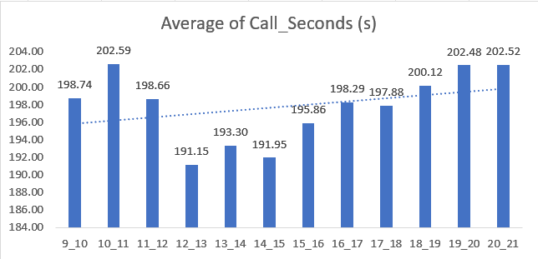
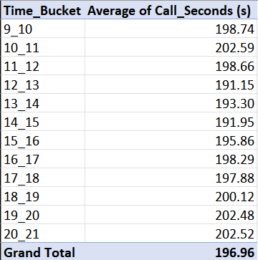
Avg. Call time duration in each bucket
The Trend of call duration is increasing from 9 am to 9 pm with overall average call duration of 196.96 seconds.
The highest average call duration is between 10 am – 11 am and 6pm – 9 pm with nearly 202.59 seconds.
The lowest average call duration is between 12-13 O’clock and between 14-15 O’clock.

Slide 7
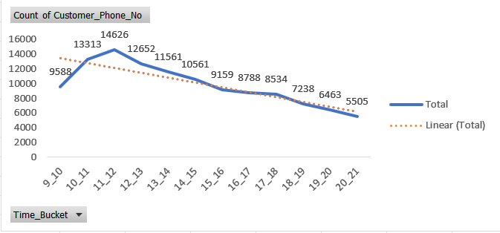
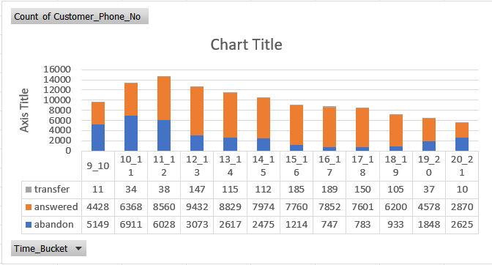
Call volume/number of calls coming
The call volume follows an overall decreasing trend where we can see at 9am to 10am it starts with 9588 peaking at between 11 am & 12 am slot with 14626 then continuously declining to 5505 in between 8pm & 9pm slot.
From the below stacked column chart we can see that the day usually starts with higher number of abandoned calls which then gradually decreases throughout the course of the day.

Slide 8
Given assumptions and formulas used
An agent work for 6 days a week; On an average total unplanned leaves per agent is 4 days a month; The total working hours of an agent is 9 hours out of which 1.5 hours goes into lunch and snacks in the office.
On an average 60% of an agent’s working hours (i.e., 60% of 7.5 hours) is occupied for his total actual on call with customers/ users. Total days in a month is 30 days.

Slide 9
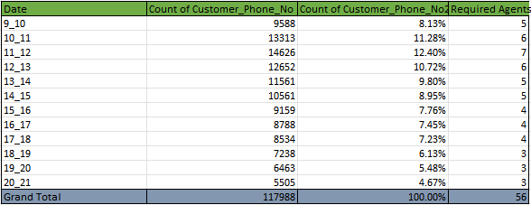
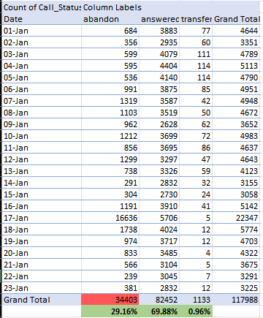
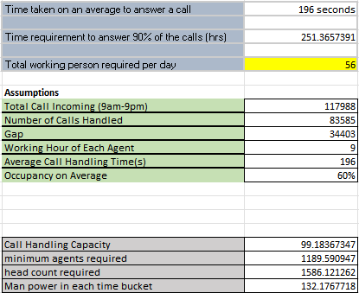
Manpower plan
Hence, for each bucket, we require 132 agents, while call handling capacity is 99, so if we multiply them, we get 13068, suggesting that 132 agents can process 13068 calls per hour.
According to the preceding slide, only 2 timeslots 10am–11am, which receives 13133 calls, and 11am–12pm, which receives 14626 calls—receive more calls than the 132 agents can handle, but not enough to exceed the 10% abandonment rate.

Slide 10
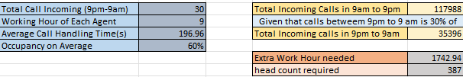
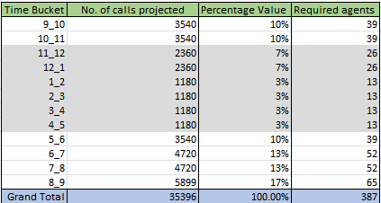
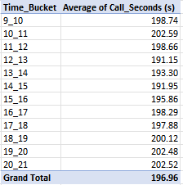
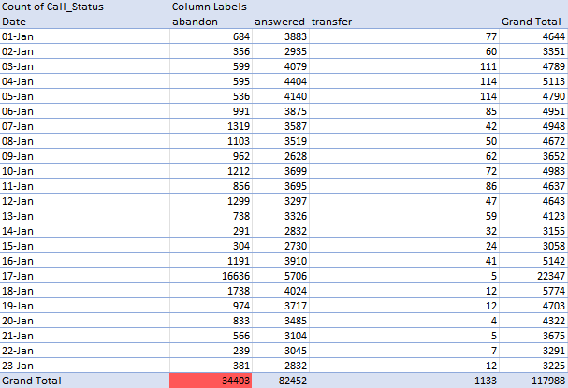
Manpower plan for 24hr
We would only require one agent if we received 30 calls. However, the answer to the question indicates that for every 100 calls we receive during the day, we receive 30 at night.
We need somewhere between 13 to 65 agents in each time bucket depending on the data provided, keeping in mind the previous rationale.

Slide 11
Conclusion
The project was helpful in providing a view of a high-stakes issue where customer pleasure, profitability. The point is how the occupations of employees are balanced need to be kept in mind. The project makes it easier to comprehend how to deal with this.
From the charts we could see the various insights, such as the average call flow throughout the working hours. The company could reduce the number of call handling agents when the call flow is low enough such as on evening hours.
From manpower plan, we can see how much call handling agents we required in each time bucket so that at least 90 calls should be answered out of 100.
Now we again proposed another manpower plan to handle calls during non-working hours. i.e., after 9pm till 9 am. From chats and applied formulas, We derived the minimum number of call handling agents are needed.

Slide 12
Thank you

